Slide 1

Introduction
The ER model was developed to facilitate database design by allowing specification of an enterprise schema that represents the overall logical structure of a database.
The ER model is very useful in mapping the meanings and interactions of real-world enterprises onto a conceptual schema.
E-R diagram represents that basic concepts of the DB schema.
Inheritance among various entity types cannot be expressed using basic E-R model.
Enhancing diagram are known as extended E-R or EER diagrams.

Slide 2
Extended E-R features
Specialization
Generalization
Aggregation

Slide 3
Specialization
Top-down design process
We designate subgroupings within an entity set that are distinctive from other entities in the set.
These subgroupings become lower-level entity sets that have attributes or participate in relationships that do not apply to the higher-level entity set.
The entity type containing common attributes known as
superclass.
The entity type which is a subset of the superclass known as subclass.
Process of refining superclass(higher level entity type) into subclasses (low level entity type) by adding some additional features to each of them is a top down design approach.

Slide 4
Generalization
A bottom-up design process
It combine a number of entity sets that share the same features into a higher-level entity set.
Specialization and generalization are simple inversions of each other; they are represented in an E-R diagram in the same way.
Depicted by a triangle component labeled ISA
ISA

Slide 5
Example
Entity set -> person
Attributes->{person_id,name,street,city}
person_id
name
street
city
person

Slide 6
A person can be further classified into following entity sets:
Customer Attributes
{customer_id,customer_name,customer_street, customer_city,credit_rating}
customer_ id
Custome r_name
customer
_street
customer
_city
Credit_r ating
customer

Slide 7
employee
Attributes ->{employee_id, employee_name,employee_street,
employee_city,salary}
employee
_id
employee
_name
employee
_street
employee
_city
salary
employee

Slide 8
The process of designing subgroupings within an entity set is called specialization.
person
ISA
employee
customer

Slide 9
We can apply specialization repeatedly to refine a design scheme.
For example : employee can be further classified as follows:
officer
Attributes ->{officer_id, officer_name, officer_street, officer_city,officer_salary,office_number}
teller
Attributes ->{teller_id, teller_name, teller_street, teller_city, teller_salary,station_number,hours_worked}
secretary
Attributes ->{secretary_id, secretary_name, secretary_street, secretary_city, secretary_salary,hours_worked}

Slide 10
It can be represented as follows:
employee
ISA
officer
teller
secretary

Slide 11
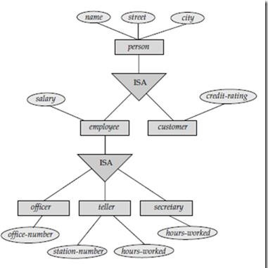
Extended ER Diagram showing Generalization and Specialization

Slide 12
Aggregation
Represent the relationships between two or more entities.
E-R diagram cannot represent the relationship
among relationship.
Aggregation represents relationship among relationship.

Slide 13
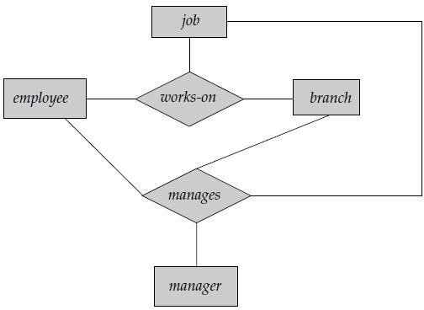
Let us consider an example:

Slide 14
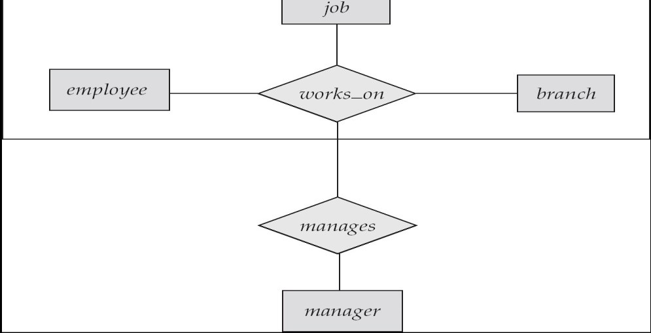
E-R Diagram WithAggregation
Without introducing redundancy, the following diagram represents:
An employee works on a particular job at a particular branch
An employee, branch, job combination may have an associated manager

Slide 15
Aggregation (Cont.)
Relationship sets works_on and manages represent overlapping information
Every manages relationship corresponds to a works_on relationship
However, some works_on relationships may not correspond to any
manages relationships
So we can’t discard the works_on relationship
Eliminate this redundancy via aggregation
Treat relationship as an abstract entity
Allows relationships between relationships
Abstraction of relationship into new entity

Slide 16
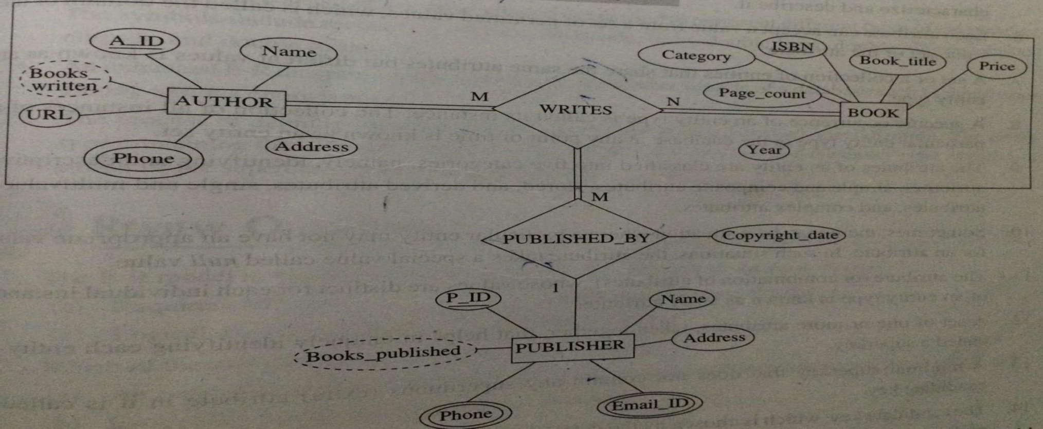
E-R Diagram WithAggregation

Slide 17
Thank You

